Slide 1

Branch - CSE Python Programming
Lecture – 12 Strings – Part 1
By
Dr. Smita Tiwari
Assistant Professor
Department of Computer Science and Engineering
School of Engineering & Technology

Slide 2
What is a String in Python?
A string is a sequence of characters.
A character is simply a symbol. For example, the English language has 26 characters.
Computers do not deal with characters.
This conversion of character to a number is called encoding, and the reverse process is decoding. ASCII and Unicode are some of the popular encodings used.
In Python, a string is a sequence of Unicode characters. Unicode was introduced to include every character in all languages and bring uniformity in encoding.

Slide 3
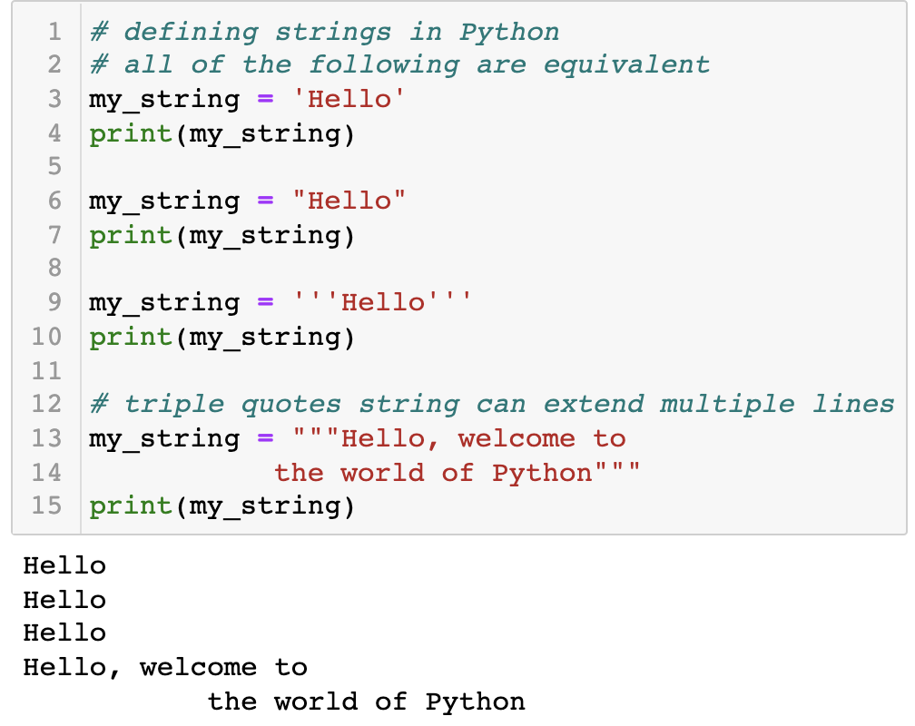
How to create a string in Python?
Strings can be created by enclosing characters inside a single quote or double-quotes.
Even triple quotes can be used in Python but generally used to represent multiline strings and docstrings.

Slide 4
How to access characters in a string?
We can access individual characters using indexing and a range of characters using slicing. Index starts from 0. Trying to access a character out of index range will raise an IndexError. The index must be an integer. We can't use floats or other types, this will result into TypeError.
Python allows negative indexing for its sequences.
The index of -1 refers to the last item, -2 to the second last item and so on. We can access a range of items in a string by using the slicing operator :(colon).

Slide 5
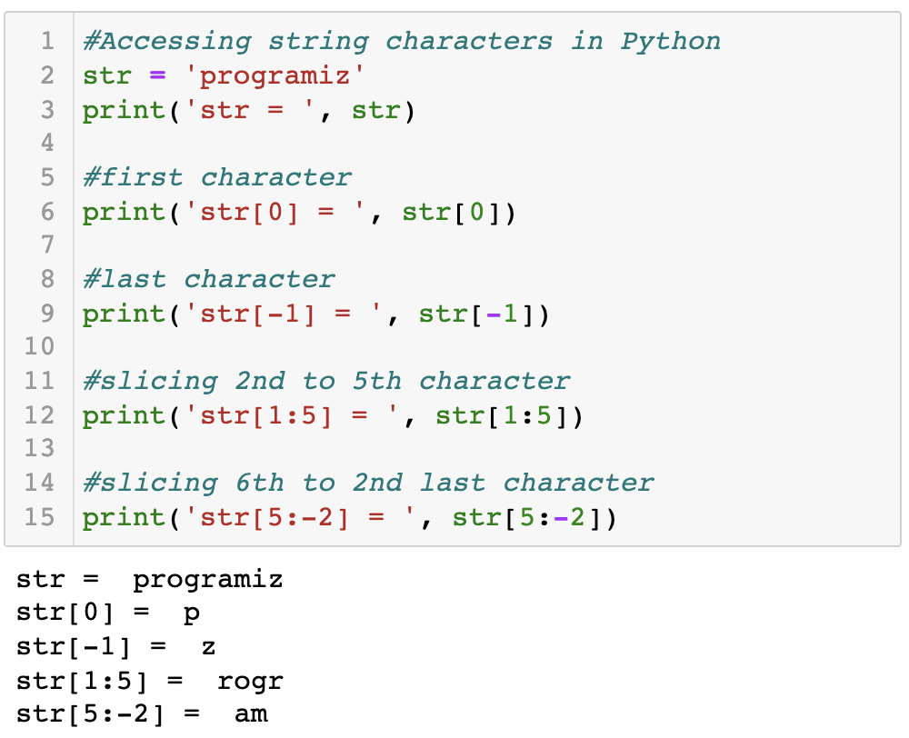
How to access characters in a string?

Slide 6
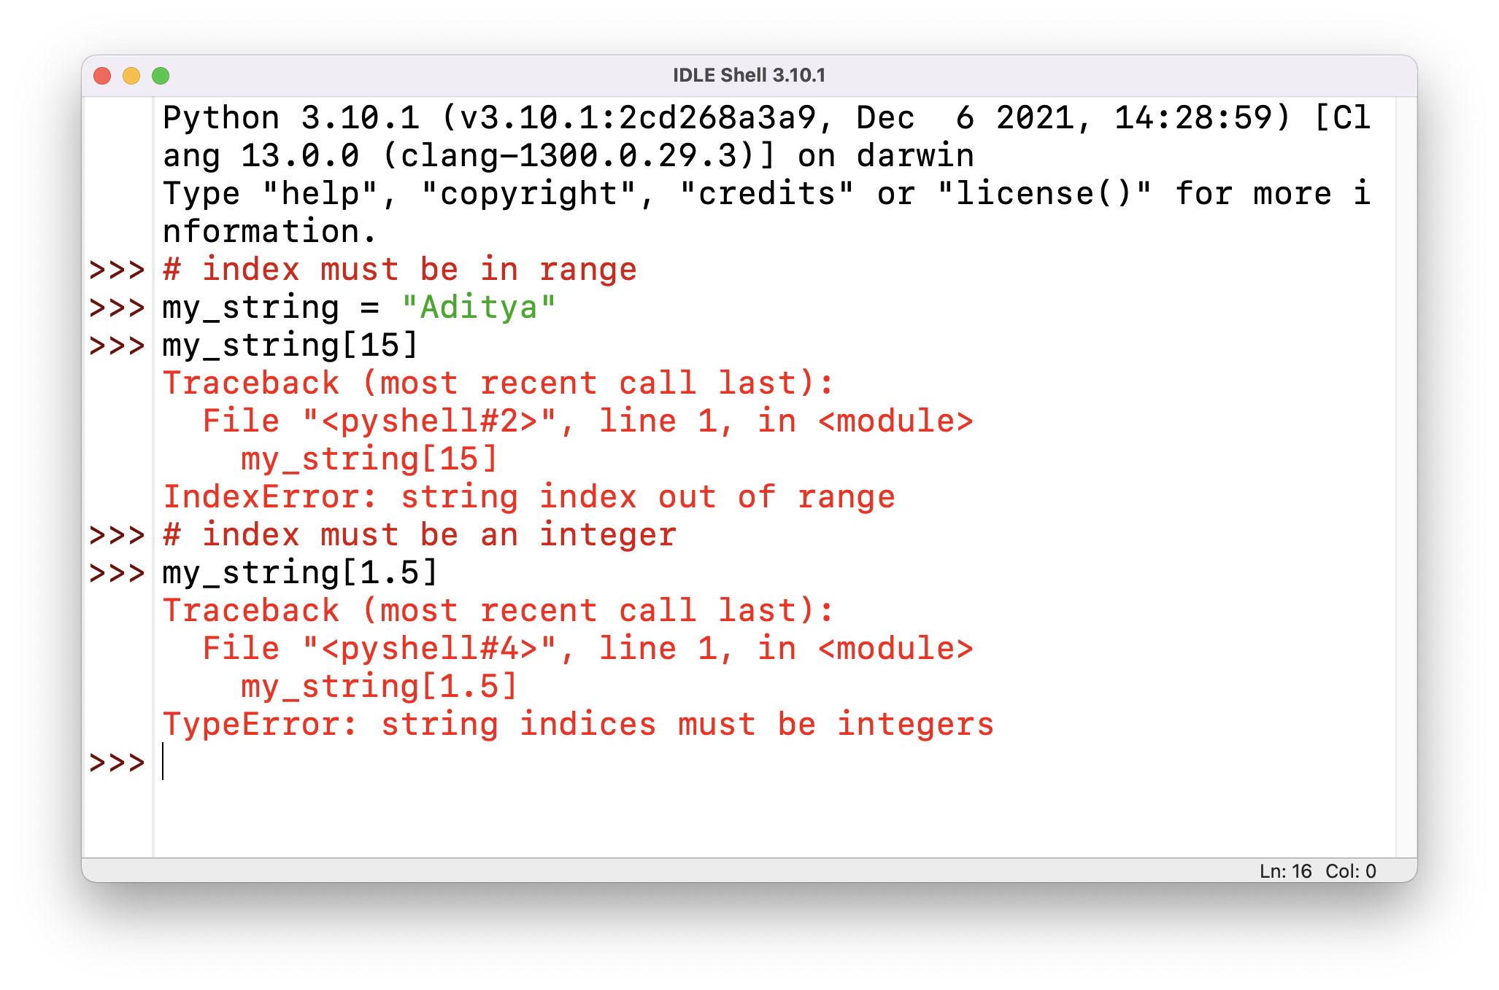
How to access characters in a string?
If we try to access an index out of the range or use numbers other than an integer, we will get errors.

Slide 7
Slicing in Strings
Slicing can be best visualized by considering the index to be between the elements as shown below.
If we want to access a range, we need the index that will slice the portion from the string.
A | D | I | T | Y | A
0 | 1 | 2 | 3 | 4 | 5
-6 | -5 | -4 | -3 | -2 | -1
Positive Indices
Negative Indices

Slide 8
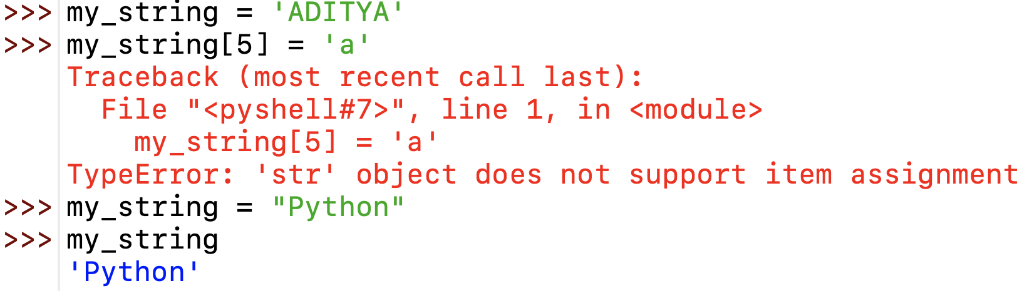
Change or Delete a string
Strings are immutable.
This means that elements of a string cannot be changed once they have been assigned.
We can simply reassign different strings to the same name.

Slide 9
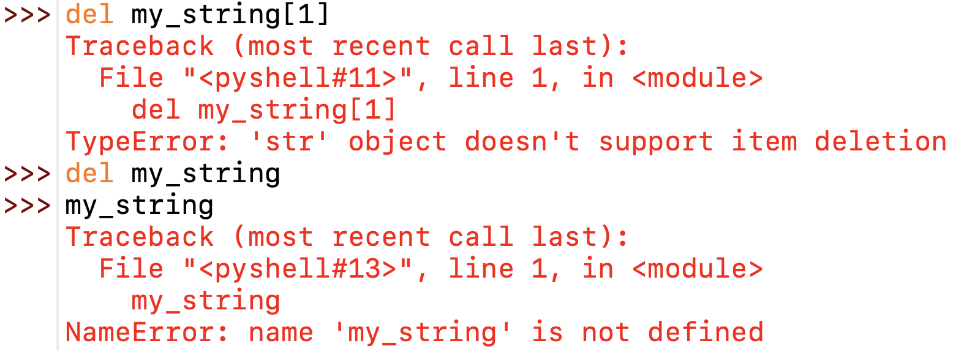
Change or Delete a string
We cannot delete or remove characters from a string. But deleting the string entirely is possible using the “del” keyword.

Slide 10
Python String Operations
There are many operations that can be performed with strings which makes it one of the most used data types in Python.
Concatenation of Two or More Strings
Joining of two or more strings into a single one is called concatenation.
The + operator does this in Python. Simply writing two string literals together also concatenates them.
The * operator can be used to repeat the string for a given number of times.

Slide 11
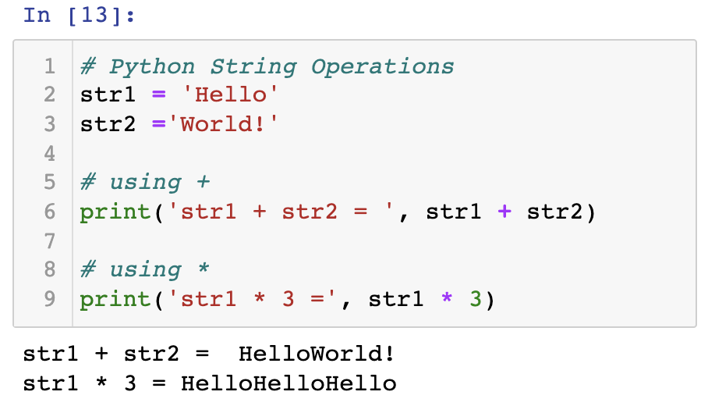

Slide 12
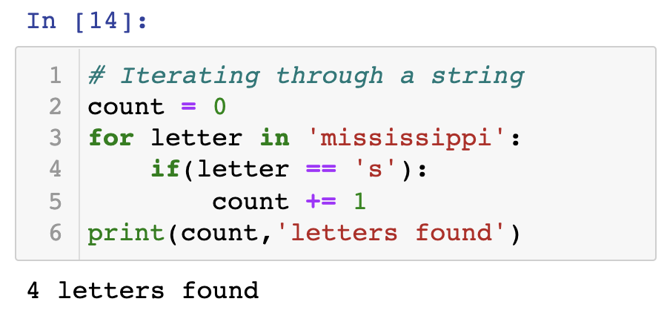
Iterating through a string
We can iterate through a string using a for loop. Here is an example to count the number of ‘s’ in a string.

Slide 13
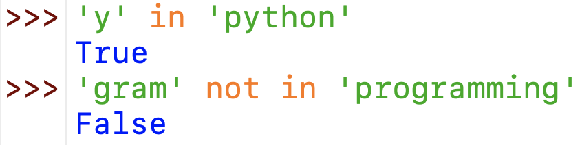
String Membership Test
We can test if a substring exists within a string or not, using the keyword ‘in’.

Slide 14
Python built-in functions for Strings

Slide 15
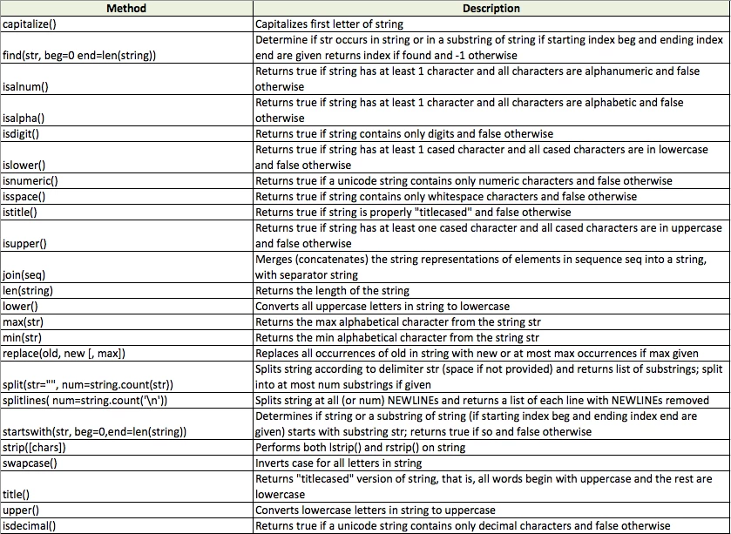

Slide 16
THANK YOU

